Slide 1

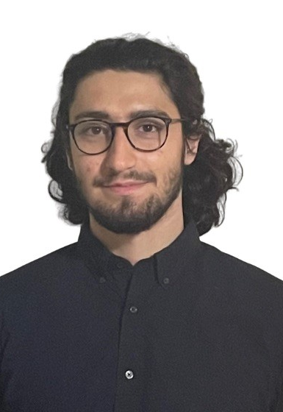
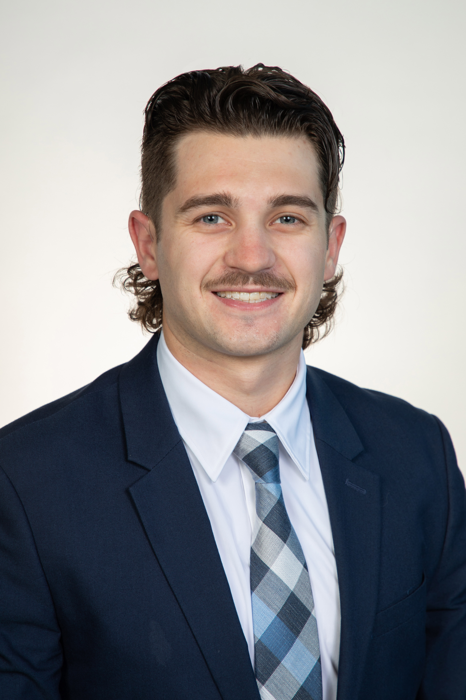
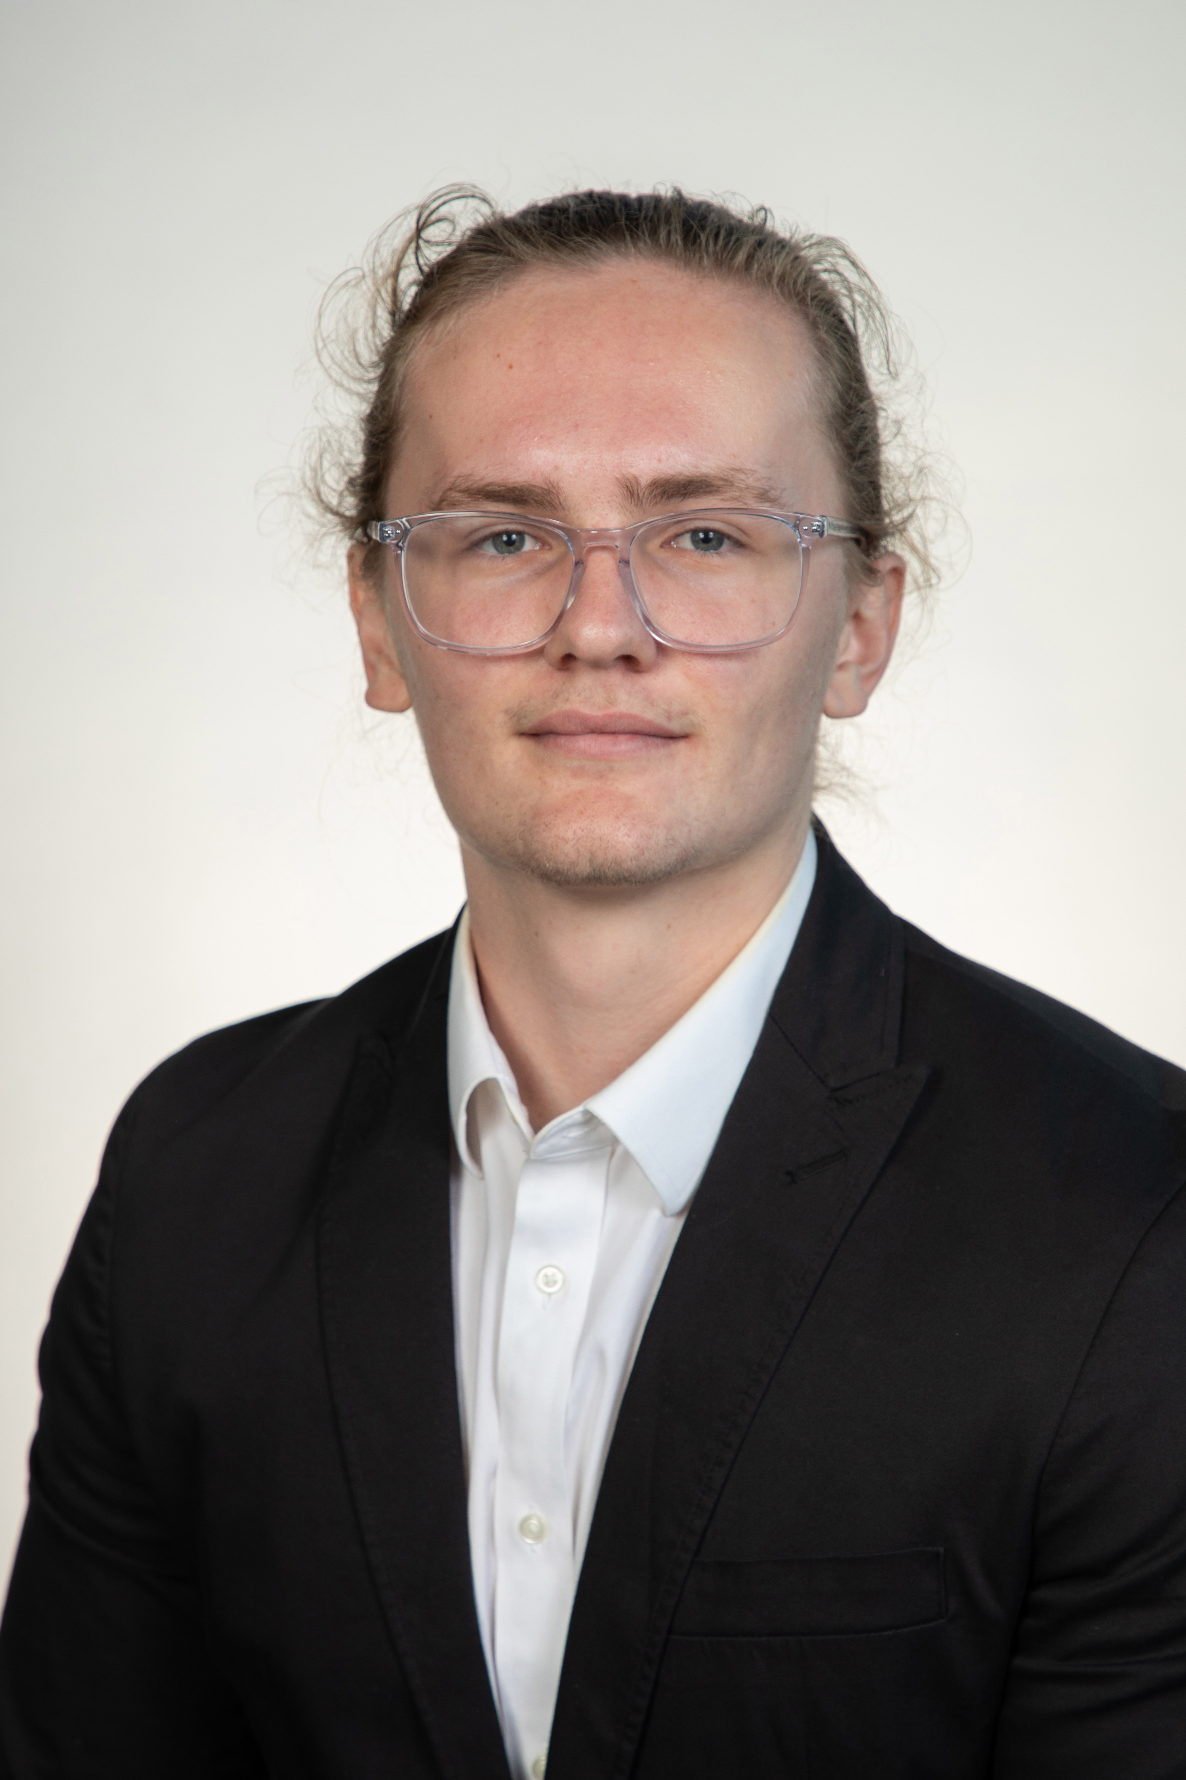
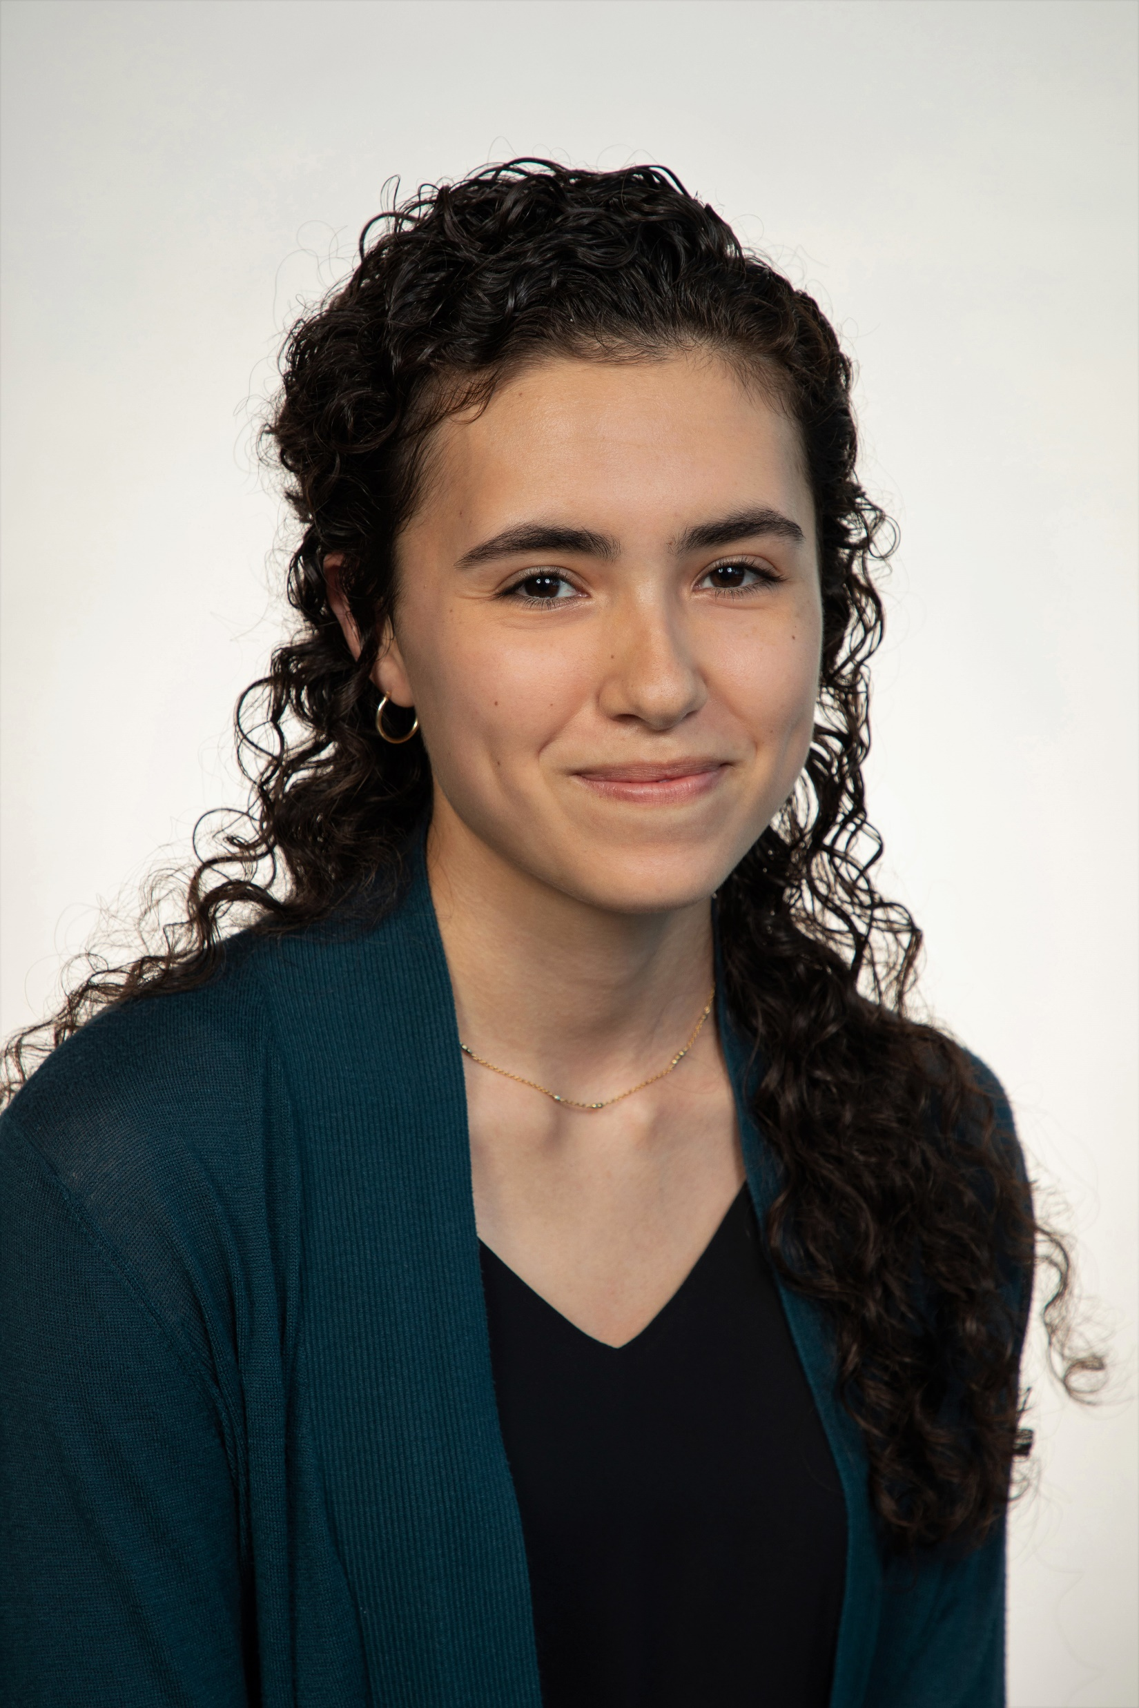
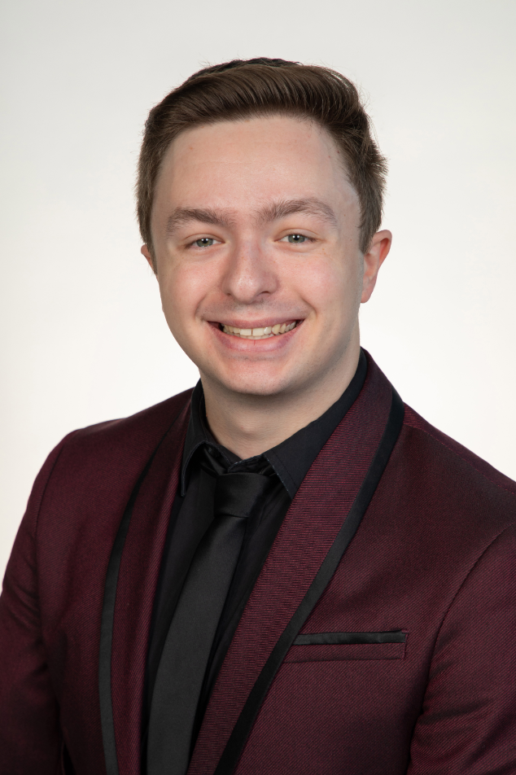
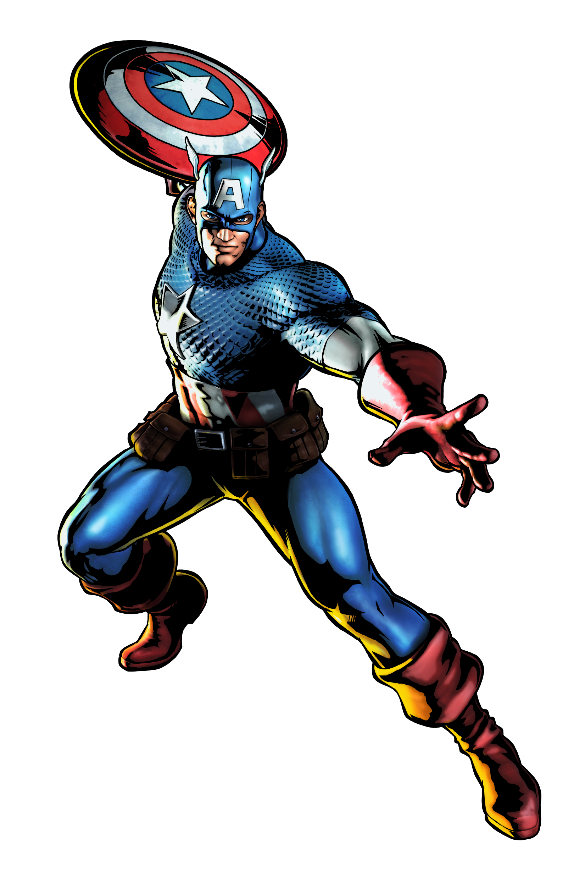
Team Introductions
Team Introductions
Zafer Jesri
Systems Engineer
Trevor Lay
Thermal Engineer
Bryson Peters
Fluids Engineer
Catherine Potts
Manufacturing Engineer
Dane Seal
Design Engineer
Catherine Potts

Slide 2
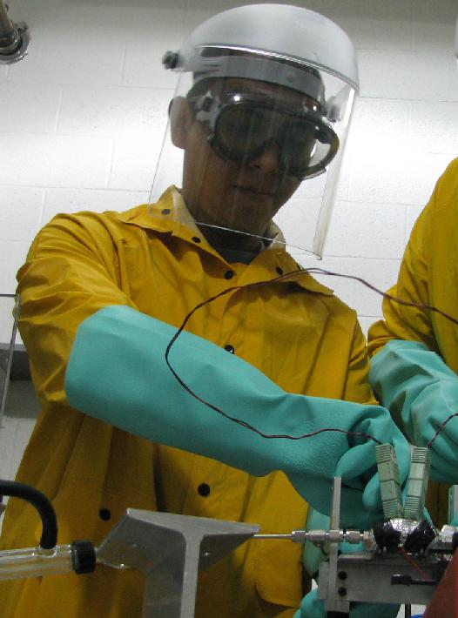
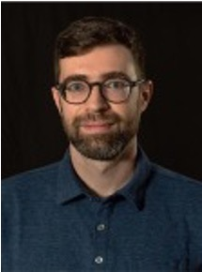
Sponsor and Advisor
Engineering Mentor
Juan Valenzuela
Aerospace Engineer
Academic Advisor
Mark Vanderlaan, Ph.D.
Head of Hybrid and Cryogenics Operations
Sponsor
National Aeronautics and Space Association
(NASA)
Catherine Potts

Slide 3

Project Objective
Create a support structure for a fiberoptic cable to measure cryogenic propellant levels in space.
Catherine Potts

Slide 4


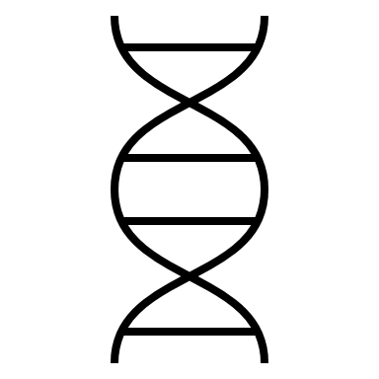
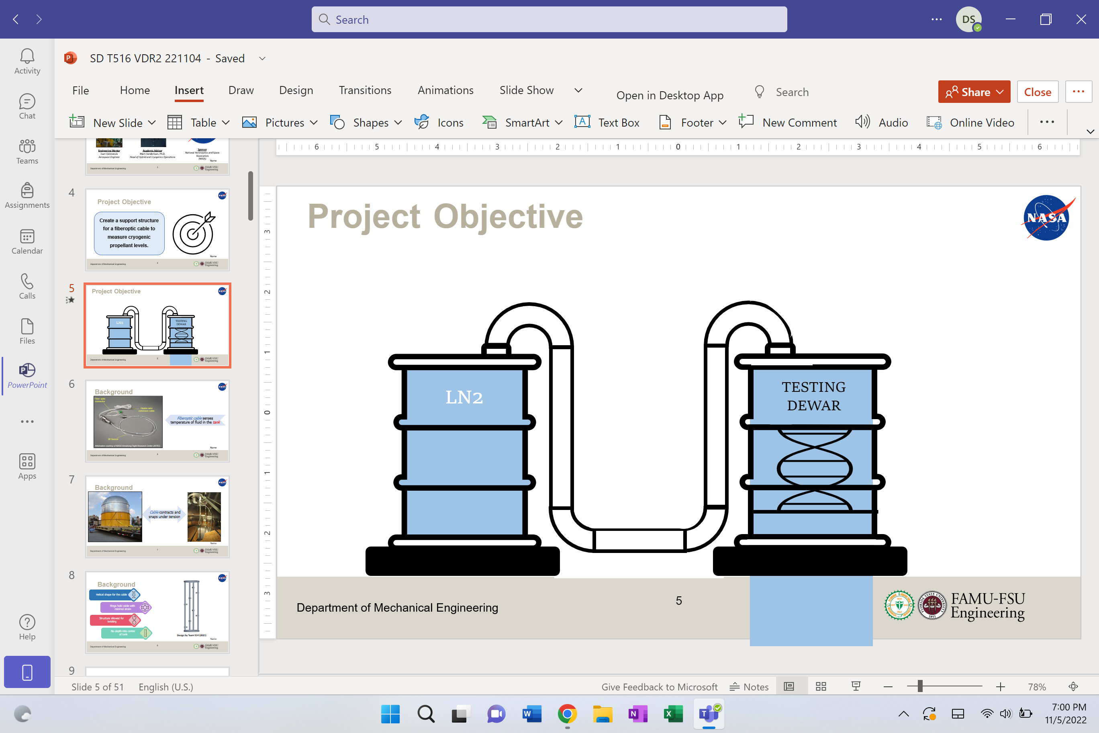
Project Objective
LN2
TESTING DEWAR
Temp = 77 K

Slide 5
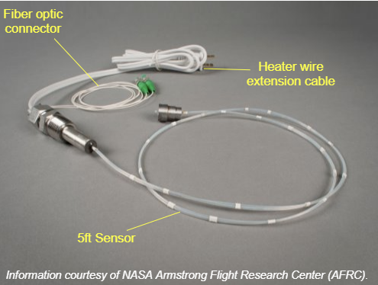
Background
Fiberoptic cable senses temperature of fluid in the tank
Catherine Potts
5

Slide 6
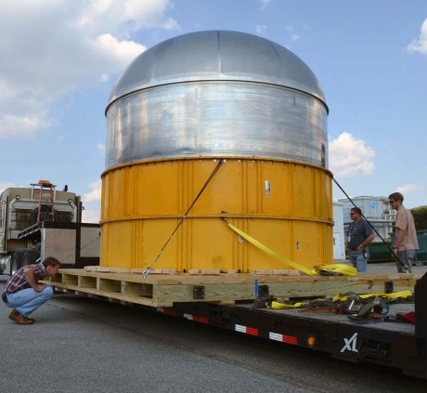
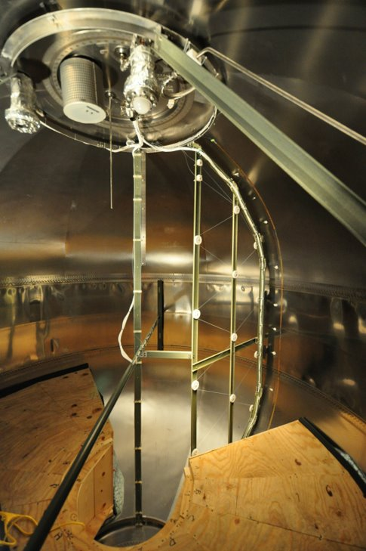
Background
Cable contracts and snaps under tension
Catherine Potts
6

Slide 7
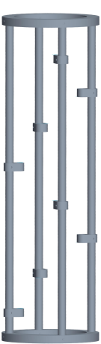
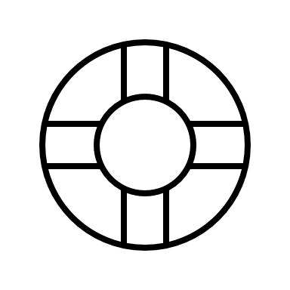
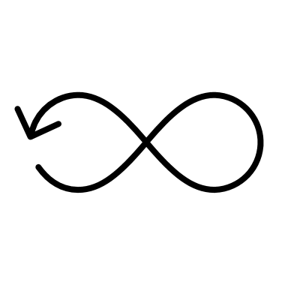

Background
Helical shape for the cable
Rings hold cable with
minimal strain
Structure allowed for
twisting
No depth into center
of tank
Design by Team 514 (2021)
Catherine Potts
7

Slide 8
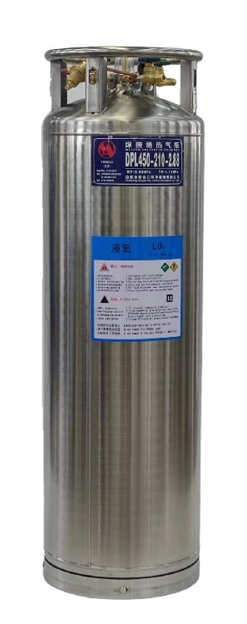
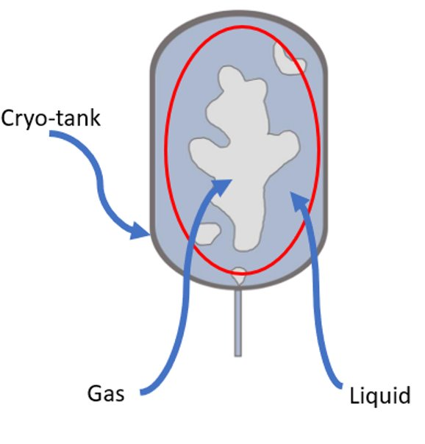
Assumptions
Testing will occur at the MAGLAB
Project Scope
Utilizing a dewar with liquid Nitrogen cryogenic testing fuel
Our structure will operate under zero-gravity conditions
The FOSS software is accurate and functional
Catherine Potts
8

Slide 9
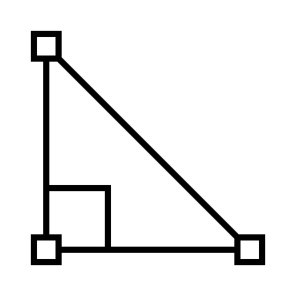




Customer Needs
Scalable Geometry
Withstands
Cryogenic Temperatures
Measures Fuel Levels
Interpret Sensor Readings
Catherine Potts
9

Slide 10
Functional Decomposition
Sensors
Structure
Power Source
Display Interface and Code
Catherine Potts
10

Slide 11






Targets and Metrics
We must ensure that the stress and strain incurred by the material at 77 K is not more than the material bounds.
The critical target for the display aspect is ensuring that our values are presented in a recognizable and presentable manner.
Sensors
The critical target dealing with the measurement system is the prevention of snapping or fracturing while exposed to LN2.
Display
POWER
Structure
Power source
supplies at least 12V​
Catherine Potts
11
Notes:
Target max stress and strain values for glass: 1KN/area, 3.5% strain

Slide 12
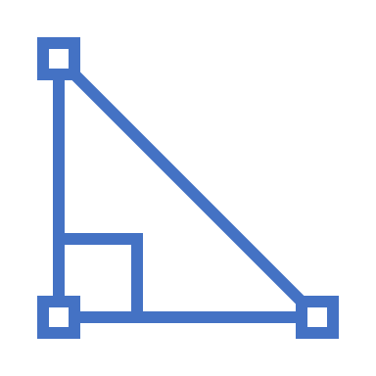


Targets
Design can be scaled to operate in tank of 17 m³
No taller than
0.66 m
Base is no wider than 0.36 m
Catherine Potts
12

Slide 13
Concept Selection
Binary
Pairwise
Comparison
House
Of
Quality
Analytical Hierarchy Process
Pugh
Chart
Final
Selection
Catherine Potts
13

Slide 14






Concept Generation
Brainstorm
Crap Shoot
Biomimicry
S.C.A.M.P.E.R.
Catherine Potts
14

Slide 15
High Fidelity Concepts
Concentric Helical Sweep Concept
Triangular Truss Concept
Honeycomb Support Concept
Catherine Potts
15

Slide 16
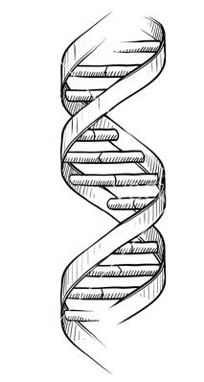
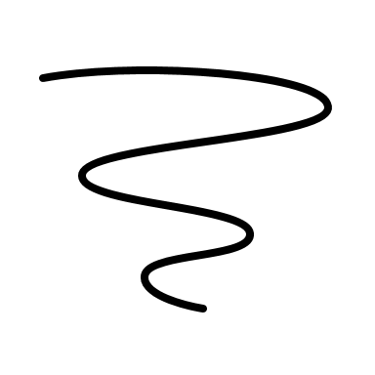

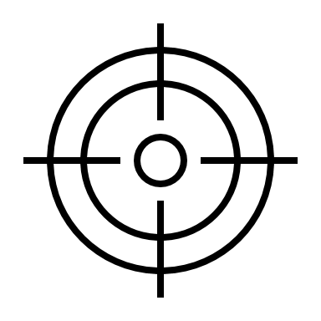



Final Selection
Nested helical sweeps of the cable
Attaching the support system to the dewar
Located in the center of the tank
Complications with open-dewar testing
Increased structural stability
Ensuring proper measurements are taken
Catherine Potts
16

Slide 17
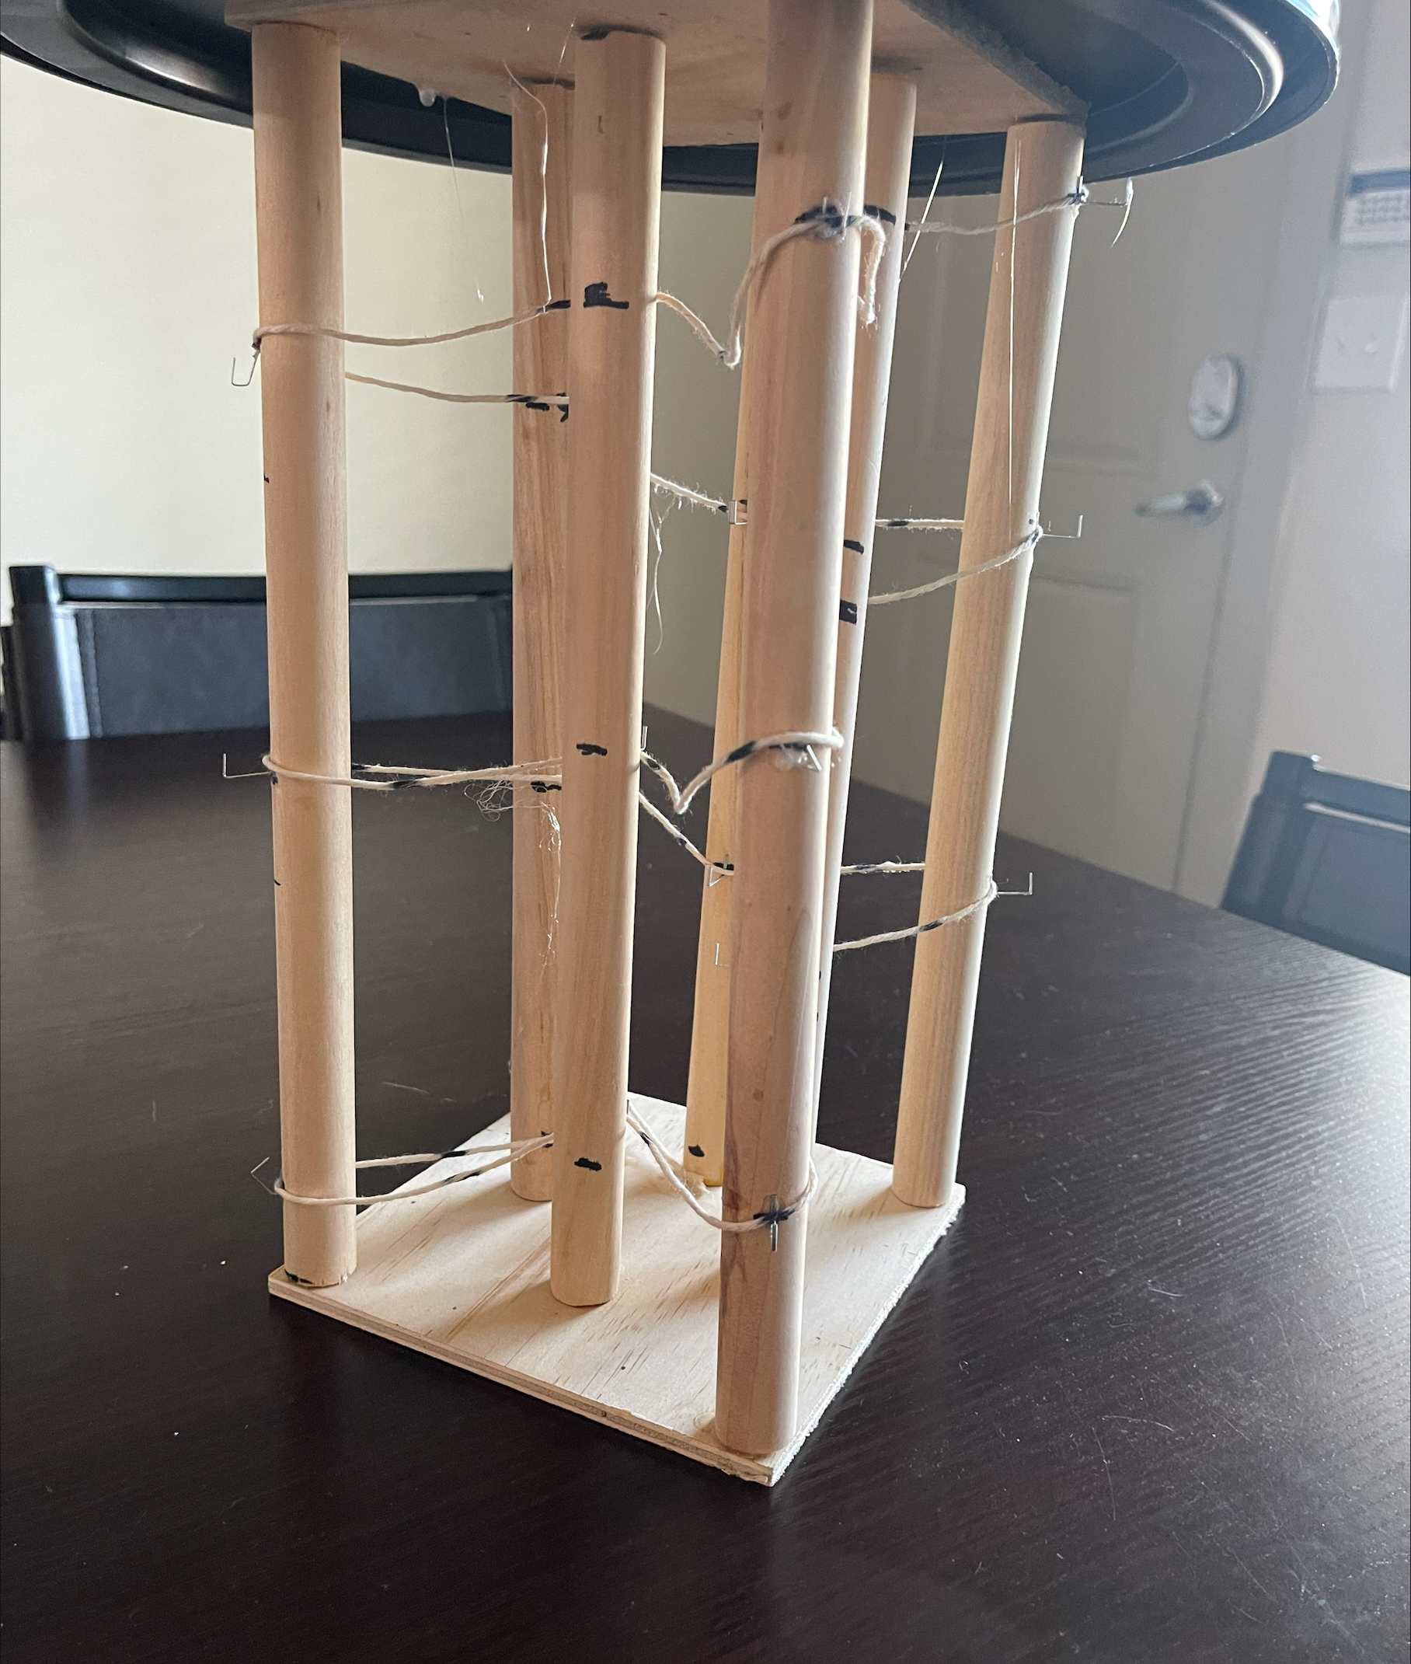
VDR4 Prototype
Made to represent our concept visually
Constructed using wooden dowels, staples, string, and super glue
Next prototype will be made using G-10
Zafer Jesri

Slide 18
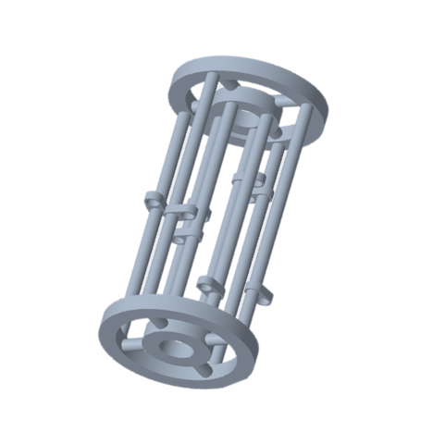
CAD Drawings
Inner Support Rings
Outer Support Rings
Connector Rods
Foss Hooks
Stabilizing Rods
Zafer Jesri

Slide 19


Design Challenges
Machining
(drill bits and material)
Dewar dimensions and constraints
Altering design to better fit FOSS cable
Zafer Jesri

Slide 20
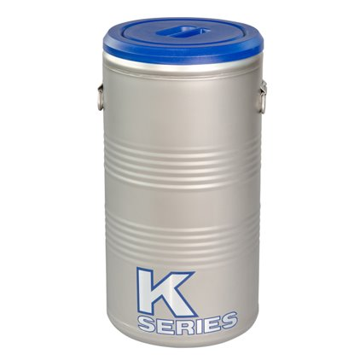
Dewar
Case 1
Case 2
Provided by MagLab
Dimension Constraints
No Cost
No Wait Time
Purchase Through CoE
Can Choose Dimensions
High Cost
Wait for Delivery
Zafer Jesri

Slide 21
Testing Procedure
Record Measurements and Rate Accuracy
Safely Remove FOSS System
Complete Safety Training
Fill Dewar With Cryogenic Fluid
Lower FOSS Structure Into Dewar
Zafer Jesri
21

Slide 22

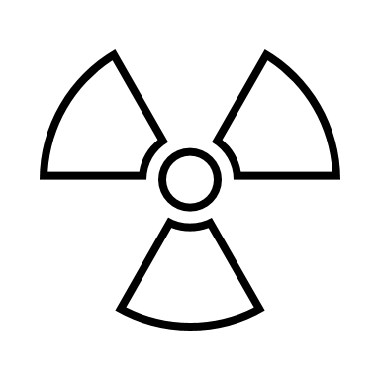
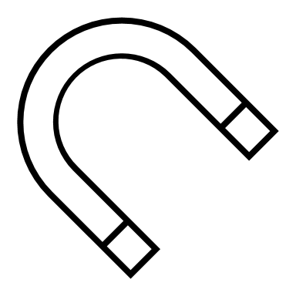
MagLab Safety Training
Cryogenic
Safety
Electrical
Safety
Hazard
Communication
Magnetic Field Safety
Zafer Jesri

Slide 23
Current Work
Safety Training for MagLab
Determine method of dewar procurement
Order parts for prototype assembly
Create a website to illustrate
design and progress
Zafer Jesri

Slide 24





Future Work
​Prototype Assembly
​Testing
Prototype
Visit NASA MSFC
​Final
Design
​Engineering Design Day (April 6)
Zafer Jesri
24

Slide 25





Summary
Zafer Jesri
25

Slide 26
Summary
The objective of our project is to create a support structure for a fiberoptic cable to accurately measure cryogenic
propellant levels.
Zafer Jesri
26

Slide 27
Summary
Assumptions:
Testing will occur at MagLab using a liquid nitrogen dewar; the
FOSS system is accurate.
Zafer Jesri
27

Slide 28
Summary
Customer needs: scalable geometry, withstanding cryogenic temperatures, measuring fuel levels and interpret the sensors
Zafer Jesri
28

Slide 29
Summary
The primary targets include measurement systems, structural integrity, power supply, and display.
Zafer Jesri
29

Slide 30
Summary
Safety training will be completed through online courses provided by the MagLab
Zafer Jesri
30

Slide 31

Summary
Dewar dimensions are critical to the advancement of the project. Determining dimensions will allow us to order the properly sized parts for prototyping.
Zafer Jesri
31

Slide 32
Functional Decomp Backup

Slide 33
Concept Selection Backup

Slide 34
Detailed Math Backup

Slide 35
Standard Shapes
Summary Box
Text box 1
Outlined Text Box

Slide 36
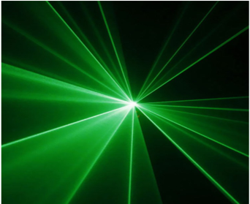
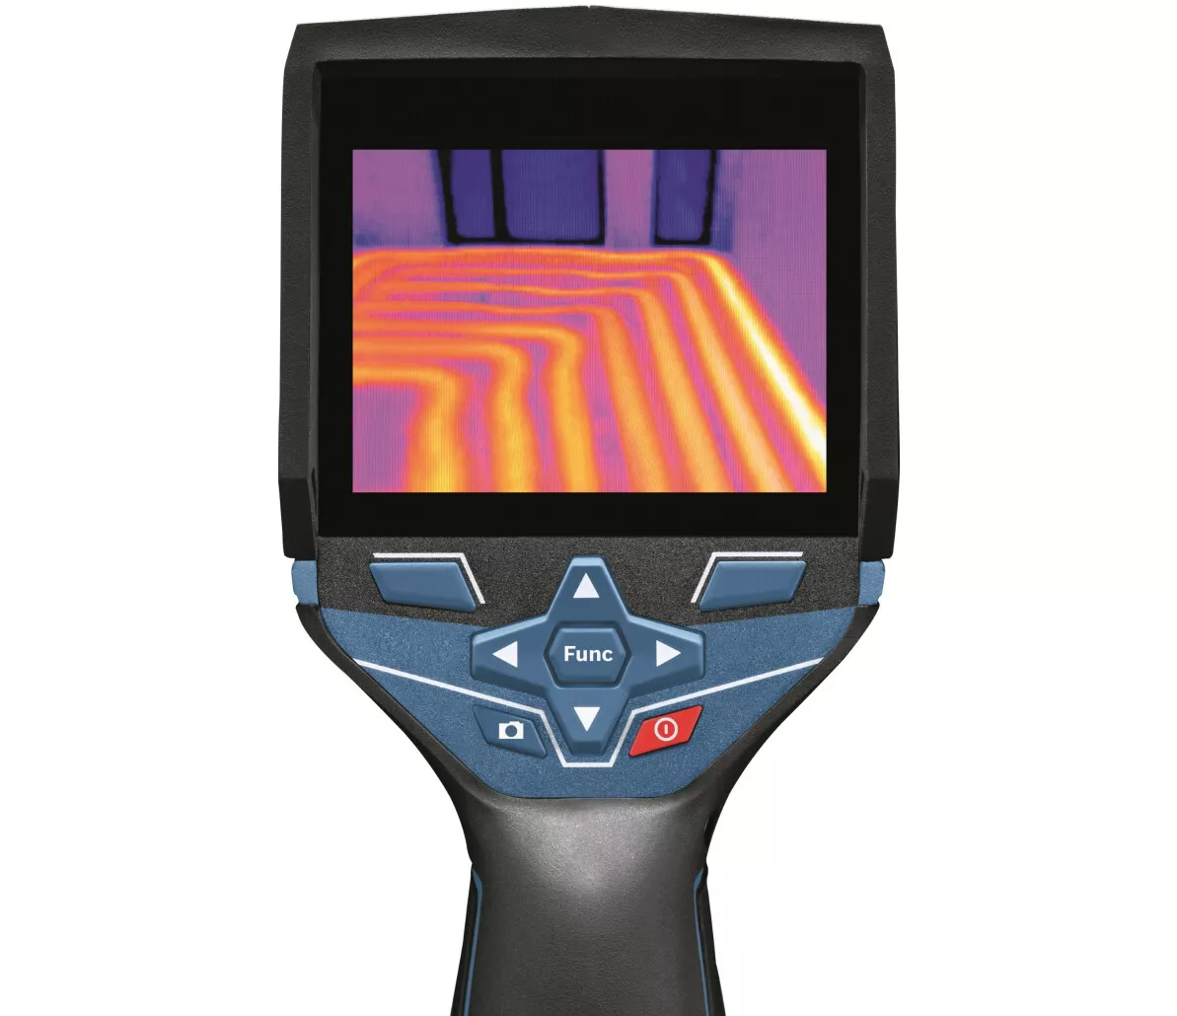

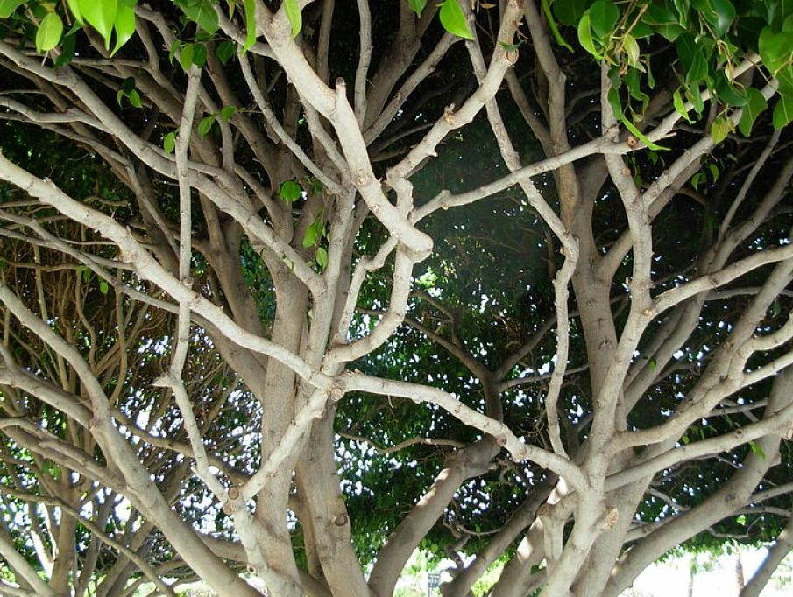
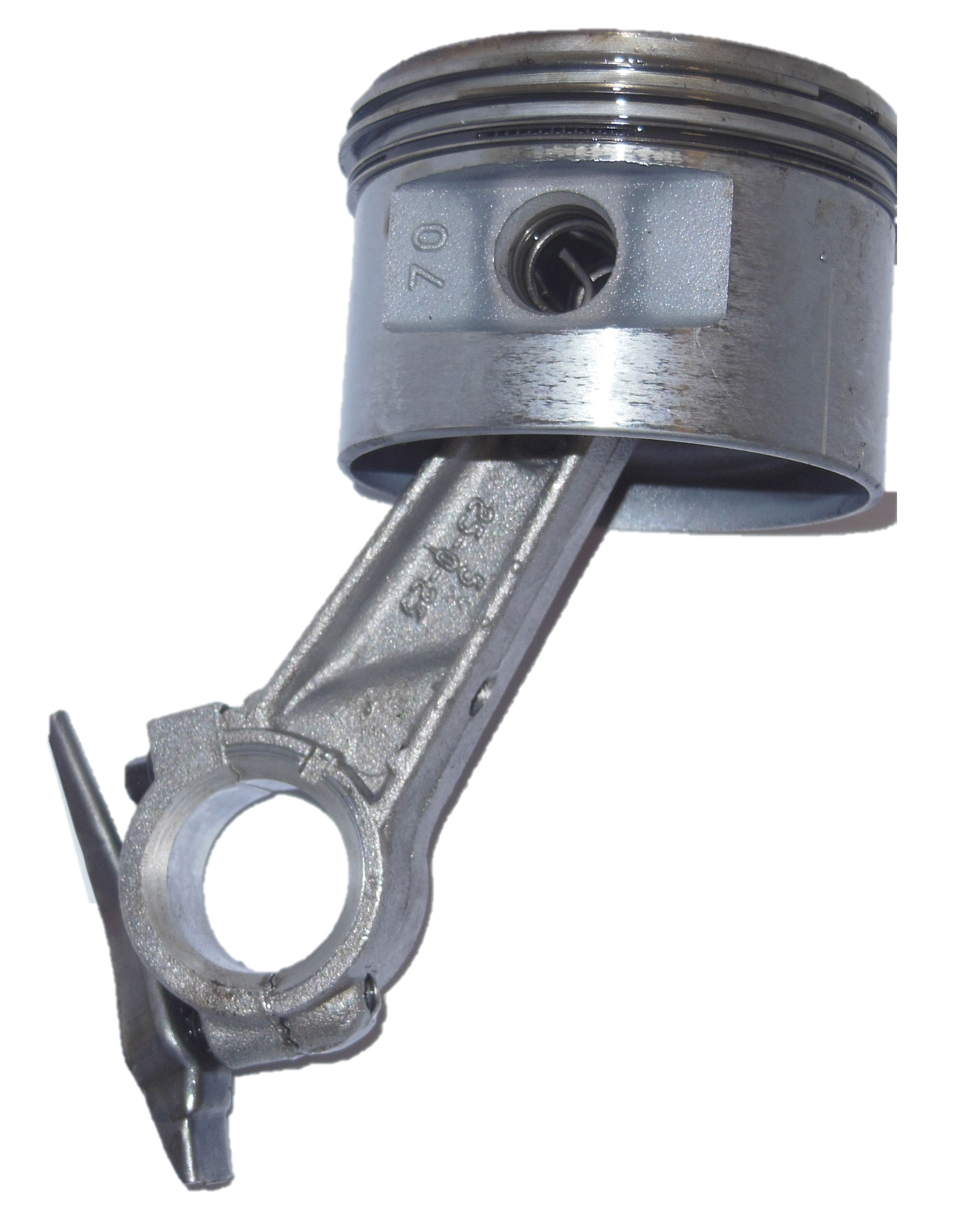
Do we still want this slide? Or nah
Name
36

Slide 37


Cool Shapes
Cable
Support Structure
Top View

Slide 38




Approved Logos

Slide 39
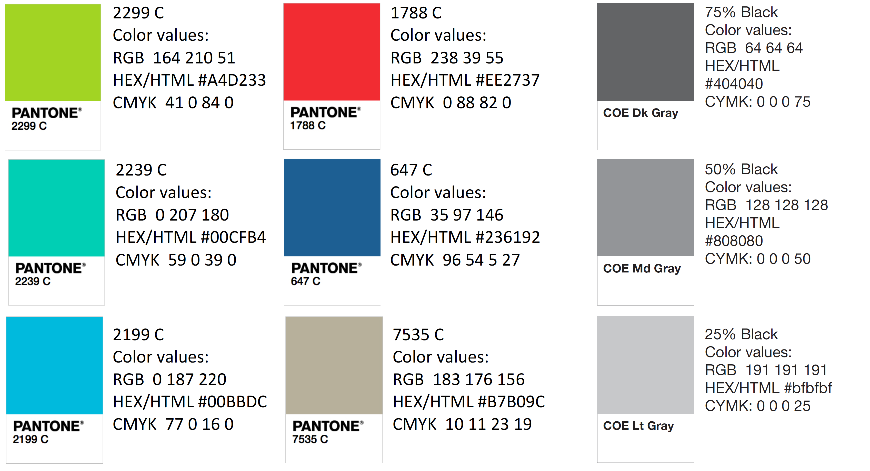
Color Palette

Slide 40
APA Tables
Category 1 | Category 2 | Category 3 | Category 4 | Category 5
Item 1
Item 2
Item 3
Item 4
 | Category 2 |  |  | Category 3
Category 1 | subcategory 1 | subcategory 2 |  | subcategory 1 | subcategory 2
Item 1
Item 2
Item 3
Item 4

